Slide 1


Self-paced Mixture of Regressions
答辩人
王栋
指导老师
高峰

Slide 2

Abstract
1 Introduction
2 Mixture of Regressions
3 SPMoR
4 Experiments
5 Conclusion

Slide 3
Abstract
Mixture of regressions (MoR) is the well established and effective approach to model discontinuous and heterogeneous data in regression problems.Existing MoR approaches assume smooth joint distribution for its good anlaytic properties.
However, such assumption makes existing MoR very sensitive to intra-component outliers (the noisy training data residing in certain components) and the inter-component imbalance (the different amounts of training data in different components).
In this paper, we make the earliest effort on Self-paced Learning (SPL) in MoR, i.e., Self-paced mixture of regressions (SPMoR) model. We propose a novel selfpaced regularizer based on the Exclusive LASSO, which improves inter-component balance of training data. As a robust learning regime, SPL pursues confidence sample reasoning. To demonstrate the
effectiveness of SPMoR, we conducted experiments on both the sythetic examples and real-world applications to age estimation and glucose estimation. The results show that SPMoR outperforms the stateof-the-arts methods.

Slide 4
1 Introduction
Nonlinear regression is a longstanding problem in artificial intelligence community with enormous applications. The fundamental approaches extract feature representations from the data and learn a nonlinear function that maps the input features to the outputs, which fall into two main categories:
(1) the universal approaches and (2) the divide and-conquer approaches.
(1) the universal approaches
These methods fit data with universal nonlinear functions to whole data space such as the kernel function in Kernel Support Vector Regression and Rectifier functions used in neural networks. These approaches can effectively improve the regression performance when facing the non-smooth data collection. However, when dealing with the piecewise continuous and heterogeneous data,they will be inevitably biased by data distribution: low regression error in densely sampled space while high error in everywhere else.

Slide 5
(2) the divide and-conquer approaches.
For addressing the issues of the data discontinuity and heterogeneity, the divide-and-conquer approaches were proposed lately. The core idea is to learn to combine multiple local regressors. For instance, the hierarchical-based and tree-based regression make hard partitions recursively, and the subsets of samples may not be homogeneous for learning local regressors.
（3）Mixture of Regressions (MoR)
distributes regression error among local regressors by maximizing likelihood in the joint input-output space. These approaches reduce overall error by fitting regression locally and reliefs the bias by discontinuous data distribution.
Unfortunately, the aforementioned approaches still cannot achieve satisfactory performance when applying in some realworld applications. The main reason is that these approaches
tend to be sensitive to the intra-component outliers and the inter-component imbalance.

Slide 6
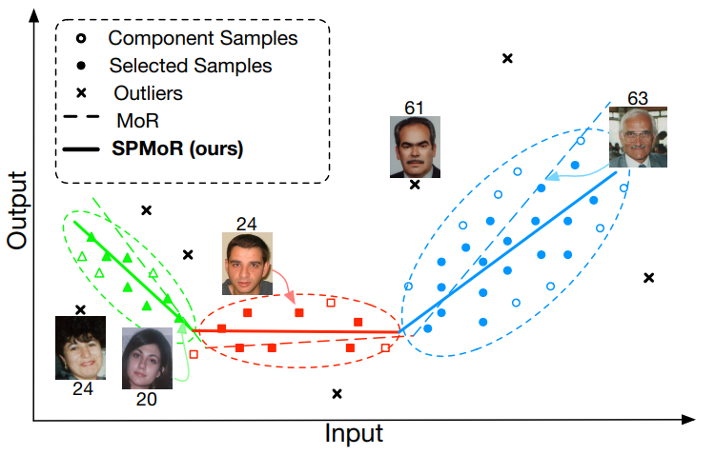
nonuniform sampled and noisy (see Figure )
For example, in the existing MoR approaches , regressors learnt from the components with more training data tend to dominant the other regressors in estimating the final output. In addition, regressors learnt with noisy training data tend to generate noisy
mapping. These will inevitably prevent the learnt regression model from reaching to the global optimum.

Slide 7
SPL
The intuition behind SPL can be explained in its analogous to human education. A pupil is supposed to understand elementary algebra before he or she can learn more advanced algebra topics. In the past few years, the effectiveness of such learning regime has been validated in a number of tasks, like event detection and co-saliency detection .
SPL is essentially a robust learning regime: starting with easier aspects of a certain task and then gradually taking more complex examples into consideration, while the noisy examples are prevented from being used throughout the learning procedure. Consequently, it can be naturally used to screen the outliers during the learning procedure and thus address noisy data in regression.
Notice that have also made efforts to build robust mixture models by using Laplace or t distribution, which do not consider conditional mixing proportions nor expand to the hierarchical framework. Compared with them, our SPMoR model overcome the sensitivity to the noisy data by introducing the effective self-paced regularizer rather than using certain types of data distribution.

Slide 8
Exclusive LASSO
The most basic self-paced regularizer is the Standard LASSO , i.e., the `1 norm, which favors selecting sparse but competing training samples,i.e., samples with small training loss or high confi-dence. More recently,have additionally introduced the negative `2,1 and negative `0.5,1 norm into the self-paced regularizer. As two kinds of the Group LASSO, `2,1 and `0.5,1 norm enforce the sparsity on variables at an intergroup level, where variables from different groups are competing to survive. Thus, their counter-part would discourage the inter-group sparsity and thus encourage the leaner to select diverse training samples residing in more groups.
we propose a novel self-paced regularizer,which is based on the Exclusive LASSO. the Exclusive LASSO is formed by the `1,2 norm, which encourages intragroup competition but discourages inter-group competition. The intra-group competition (sparsity) is achieved via `1 norm, while inter-group non-sparsity, i.e., diversity, is achieved via`2 norm. On one hand, the encouraged intra-group competition will prevent the learner from using the outlier data within each component. On the other hand, the discouraged inter-group competition will induce the learner to select balanced training data from different components.

Slide 9
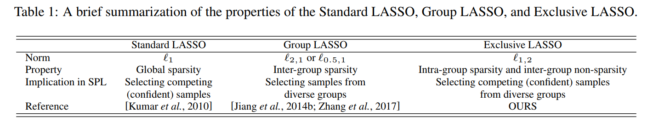
A brief summarization of the properties of the Standard LASSO, Group LASSO, and Exclusive LASSO is shown in Table.In sum, this paper present three major contributions:
• The earliest effort to use SPL to MoR, which effectively address the intra-component outlier and the intercomponent imbalance problem of the existing MoRs.
• A novel Exclusive LASSO based self-paced regularizer, which simultaneously encourages the intra-group competition and discourages inter-group competition.
• Significantly superior performance than other regression models and self-paced regulaizers on two real-word applications. To our knowledge, SPMoR achieves the best performance ever reported in literature on MORPH and NHANES datasets.

Slide 10
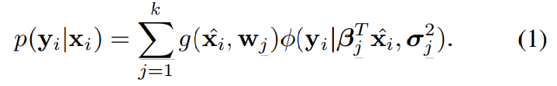
2 Mixture of Regressions
The standard MoR consists of a fully conditional mixture model where both the gating functions and the experts, are conditional on input features. Specifically, given xi ∈ <dx (the training sample) and yi ∈ <dy (the output vector), MoR splits the n pairs of samples {xi, yi}s into k components and learn a weighted linear regressor for each component. The total probability of generating yi from input xi
is the mixture of the the probabilities of generating yi from each component density, where the gating function provides multinomial probabilities. The conditional density of MoR is computed
by summing over all local regressors:
where β = {β1, β2, · · · , βk}, w = {w1, w2, · · · , wk}, σ ={σ1,σ2, · · · ,σk}, wj is the gating function parameter, βj ∈< dy×(dx+1) is the regression coefficients, xˆ = [1, x], g(·) is the gating function, e.g., softmax function, which is positive and sum to 1, φ(·) is a density function of regression error,e.g., Gaussian error N (0,σ2).

Slide 11
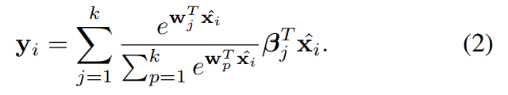
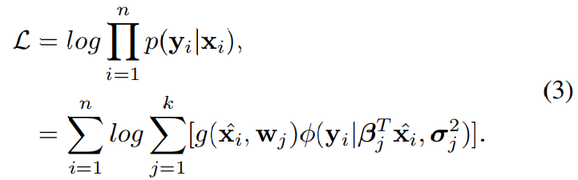
The output yi is estimated as a weighted combination over all local regressors:
The MoR model parameters are estimated by maximizing the observed data log-likelihood via using the EM algorithm. The observed data log-likelihood for the parameter vector is
For optimizing (3), the E-Step at each iteration of the EM algorithm requires the calculation of the following posterior probability zij that the sample (xi , yi) belongs to the jth expert, given a parameter estimation wj , βj and σj . Then,the M-step calculates the parameter update wj , βj and σj by maximizing the expected complete-data log-likelihood for each expert where zij is fixed.

Slide 12
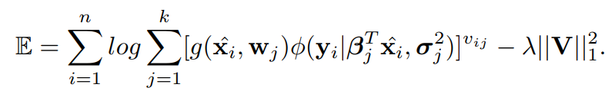
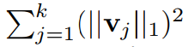
3 SPMoR
The Object Function
Without loss of generality, we introduce the method to obtain SPMoR by integrating the proposed self-paced regularizer with the standard MoR model. By using the proposed method, we can also integrate the self-paced regularizer with the stronger hierarchical mixture of experts model which obtains the SPMoR+ model by using Bayes’rule
vij ∈ {0, 1} is the learning weight of each training sample, which represents whether the sample xi has been selected by self-paced learning for jth component. ||V||2 1 = is the Exclusive LASSO, which is a combination of the `1 and `2 norms.
when λ is small, only the samples with high likelihood, gate probability is close to 1, and density is larger than 1, will be chosen as training data.

Slide 13
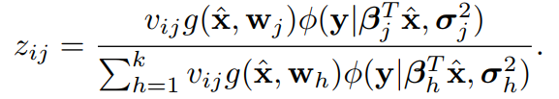
The Optimization
To maximize log-likelihood function, the generalized EM algorithm starts from an initial parameter vector and alternates between E-step and M-step until convergence. The E-step computes the expected completed data log-likelihood and the M-step maximizes it.
E-Step
Similar with the standard MoR, we compute the posterior probability zij of function 4 in the E-step. Specifically, given the initial parameters, we can obtain
where vij indicates that whether the sample is chosen by selfpaced learning. If vij = 0 for all the components, then the sample is eliminated from training procedure. If all vij = 1, it is the same as the function of the conventional MoR.

Slide 14
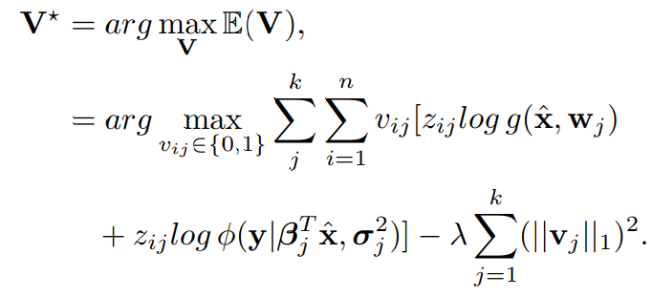
M-step
In M-step, we fix zij and utilize the alternative convex search (ACS) to alternatively optimizes w, β,σ and V.
Updating Self-paced Parameter:
Firstly, we fix the parameters w, β,σ of the gating function and local regressors to optimize V as following
where V ∈ <n×k, each element vij in the matrix indicates the sample xi’s “easiness” in j
th component. Here, “easiness” means the confidence of the sample, which indicates whether
the sample should be used for training. By contrast, zij indicates the probability that sample belongs to jth component.

Slide 15
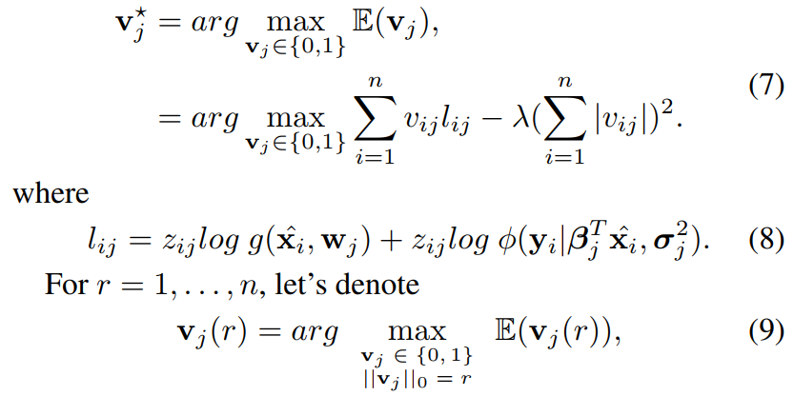
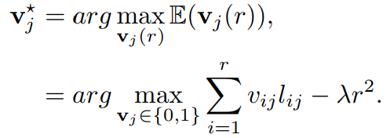
It is easy to see that the original problem (6) can be equivalently decomposed as a series of the following suboptimization problems (j = 1, . . . , k):
which means that vj (r) is the optimum of function (7) if it is further constrained to be with r nonzero entries. It is then easy to deduce that

Slide 16
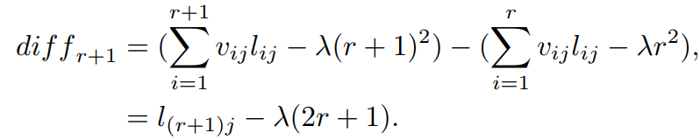
Then let’s calculate the difference between any two adjacent elements in the sequence E(vj (r)).
Here, we sort the log-likelihood values in the jth component in descent order. Then, lij is a monotonically decreasing sequence with r, while 2r + 1 is a monotonically increasing sequence. So diffr is a monotonically decreasing sequence. When diffr → 0 and diffr > 0, we can get the function E(vj (r)) is increasing more and more slowly. When diffr <0, the log-likelihood value will be decreasing. Therefore, in function (11) E(vj (r)) will get the maximum value when diff r = 0. Finally, we can get the optimal solution for vj in jth component. For all r = 1, . . . , n, if lrj > λ(2r − 1), then vrj = 1; otherwise, vrj = 0.

Slide 17
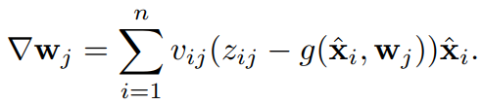
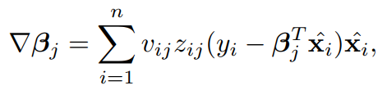
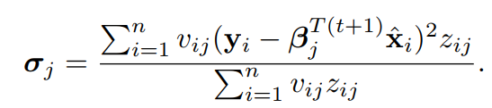
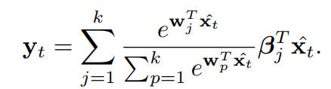
Updating MoE parameter:
After updating the self-paced parameter V, we can fix vij and zij to update the MoE parameters w, β and σ. Here, we use Iteratively Reweighted Least Squares (IRLS) algorithmto update the gating function and experts function:
1) For the jth gating function, the gradient of any sample xi is obtained by:
2) For the jth regression coefficients, the gradient is obtained by:
and the corresponding variance σj is obtained by:
Given a test input xt ∈ <dx , the output of SMMR, yt ∈<dy , is computed as (15).

Slide 18
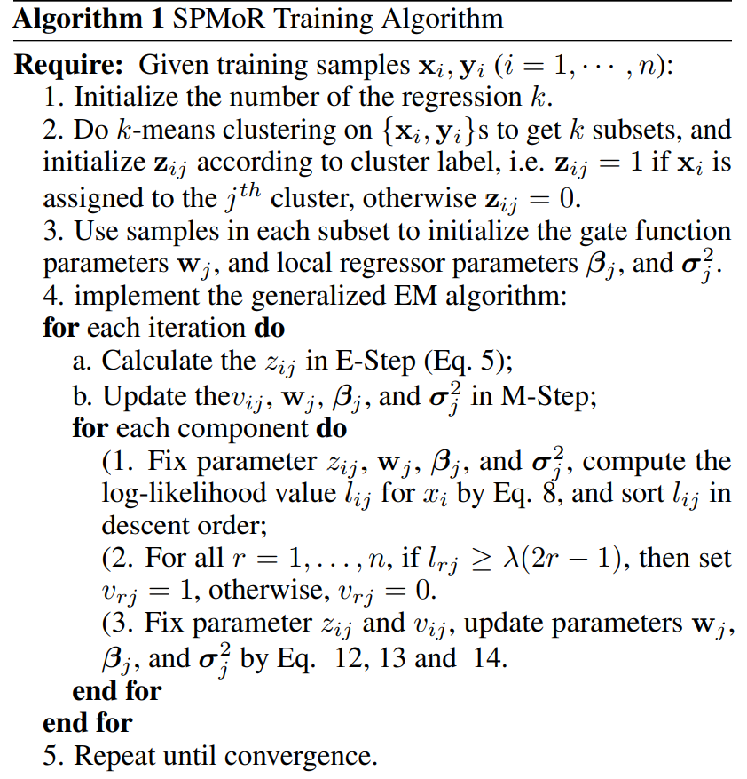
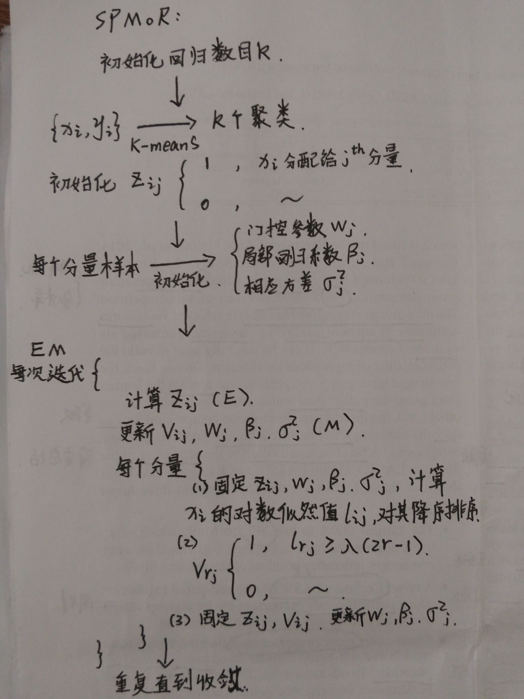

Slide 19
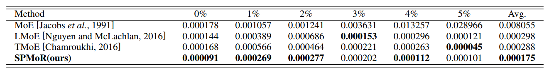
4 Experiments
Setting 1:
In this experiment we mainly examine the robustness of the proposed model to outliers by comparing with the standard MoR and another two existing robust MoR methods. Specifically, we followed the same settings with [Chamroukhi,2016] to generate the simulated data: we simulated 500 observations from a k = 2 component MoR with (1), where the parameter components were w1 = (0, 10)T, w2 = (0, 0)T,β1 = (0, 1)T, β2 = (0, −1)T and σ1 = σ2 = 0.1. The feature xi was simulated uniformly over interval (-1, 1). Outliers (0% - 5% of 500 observations) were also generated by simulating xi uniformly over the interval (-1,1), while setting y = −2. To assess robustness, the mean squared error (MSE) between each component of the true parameter vector and the estimated one, were averaged on 100 trails and reported in Table 2. As it can be observed, the parameter estimation error of our method (SPMoR) can stay in relative smaller values, which demonstrates the robustness of the proposed algorithm outperforms the existing robust MoR methods.

Slide 20
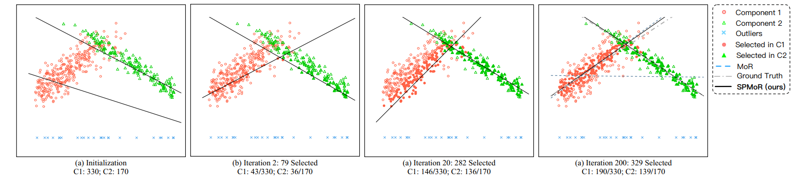
Setting 2:
In this experiment, we subjectively evaluated theeffectiveness of the proposed algorithm. from which we
can observe that due to the intra-component outliers and the inter-component imbalance, the initial regressors as well as the standard MoR cannot fit to the data well. Whereas along the learning iteration, our algorithm (SPMoR) can graduallyrevise the local regressors by inferring the reliable training data from each component.
As can be seen from Figure 2, with a feasible λ, it seeks to select more even set of “easy” samples from each component. Specifically, in each iteration, it prefers to select the confi-dant samples which are the easy-separable points with small regression-errors. So the posterior probabilities zij for the selected
samples tend to be equal to 1, which makes the varianceσj for each component is similar and small. Consequently, the learner tends to select samples within similar and small bandwidth from each component which leads to the increase of the balance of the selected training data.

Slide 21
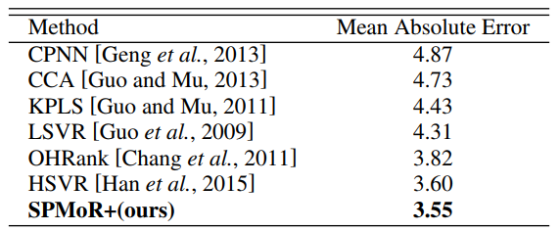
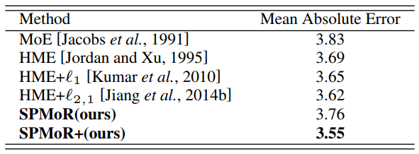
Age Estimation
Dataset: Longitudinal Morphological Face Database(MORPH) database, which contains 55,132 face images from more than 13, 000 subjects. The ages of the subjects range from 16 to 77 with a median age of 33. The faces are from different races, including African, European, Hispanic, Asian, Indian, et al.
Experimental settings: We used the 4,376 BIF features We used the 4,376 BIF features to represent each image and followed to reduce the feature dimension to 200 by using the marginal Fisher analysis. Note that both SPMoR and SPMoR+ used softmax in partition and linear local regressors. In SPMoR, we set k to 9, and λ to 1e-05. In SPMoR+, we set k to 8, and λ to 1e-05. The SPMoR+ approach will be converged after 70 iterations, The running time of our method is 565 seconds, which is faster than HME which needs 48 iterations but costs 589 seconds.

Slide 22
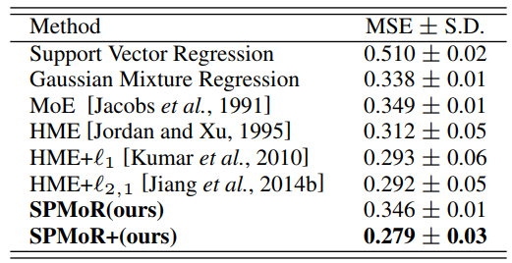
Glucose Estimation
Dataset:
We conducted experiments on the popular 2009-2014 National Health and Nutrition Examination Survey(NHANES) dataset , which is the crosssectional data and the ground-truth HbA1c data were publicly available. The amount of all available data is 8,271.
Experimental settings:
we compared our approach with 6 baseline models under the same protocol of Age Estimation. We randomly shuffled the dataset 100 times, and divided the data into two parts: 80% for training and the other 20% for test. All the results were evaluated by Mean Squared Error (MSE) and the Standard Deviation (S.D.). In SPMoR, we set k to 5, and λ to 1e-05. In SPMoR+, we set
k to 16, and λ to 1e-04.

Slide 23
5 Conclusion
We have proposed a novel SPL-based framework to effectively overcome limitations of MoR under nonuniform sampled and noisy real-world data. To our knowledge, this is the earliest effort to build self-paced regularizer based on the Exclusive LASSO, and to directly avoid the intra-component outlier and the inter-component imbalance problems in existing MoR approaches. Comprehensive experiments on the simulation data and two real-world tasks have demonstrated the effectiveness of the proposed approach. In the future, we will explore soft weighting regularizers in MoRs and appliy our approach in more computer vision tasks like object tracking [Supancic and Ramanan, 2013], co-saliency detection [Zhang et al., 2016], and object detection [Cheng et al., 2016].

